Slide 2
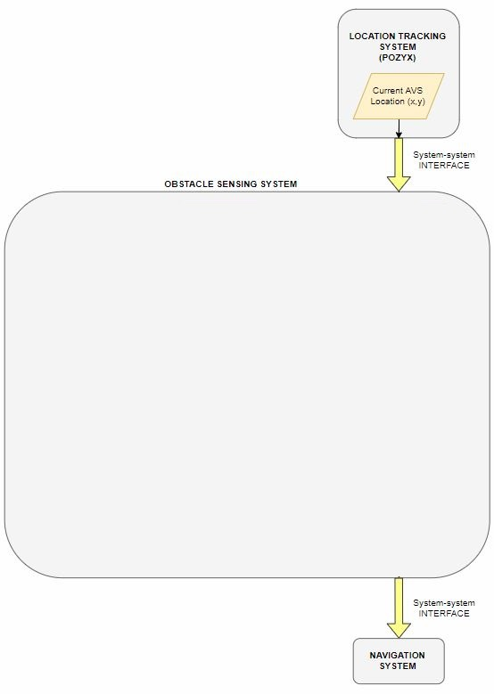
Obstacle Detection System – Black box
Purpose: To detect and locate obstacles inform navigation decisions.
Requirements:
Detect obstacles within the range constraints of the HC-SR04 sensors (2cm – 400cm)
Output the grid reference location of detected obstacles to the navigation system
External Interfaces:
INPUT: Location System
Current location
Current heading angle
OUTPUT: Navigation System
Grid reference of detected obstacle

Slide 3
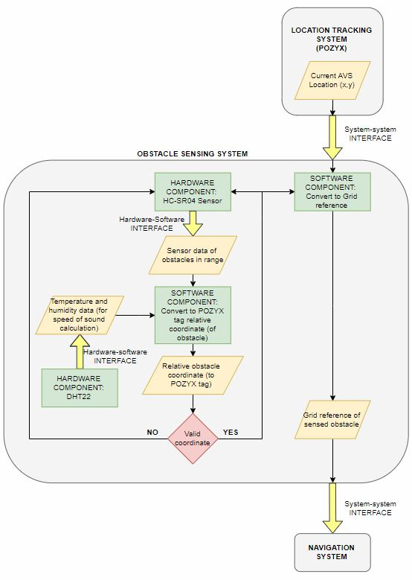
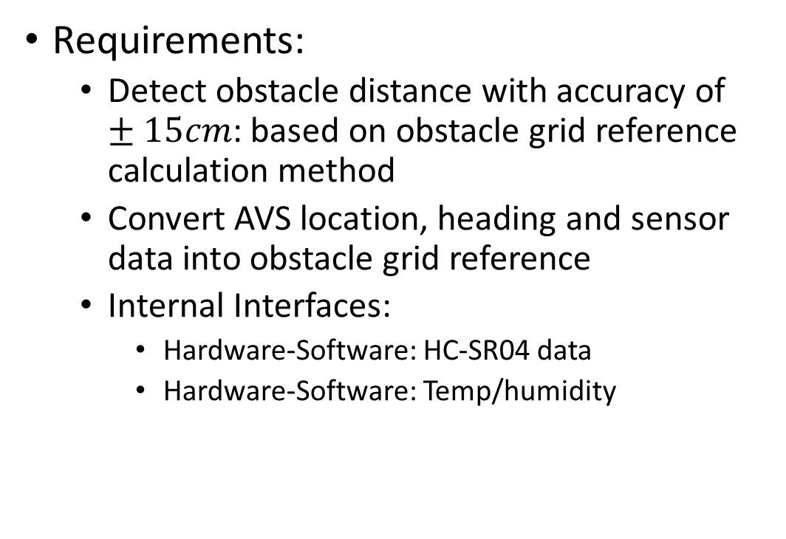
Obstacle Detection System - Internal
Requirements:
Detect obstacle distance with accuracy of $±15cm$: based on obstacle grid reference calculation method
Convert AVS location, heading and sensor data into obstacle grid reference
Internal Interfaces:
Hardware-Software: HC-SR04 data
Hardware-Software: Temp/humidity

Slide 4
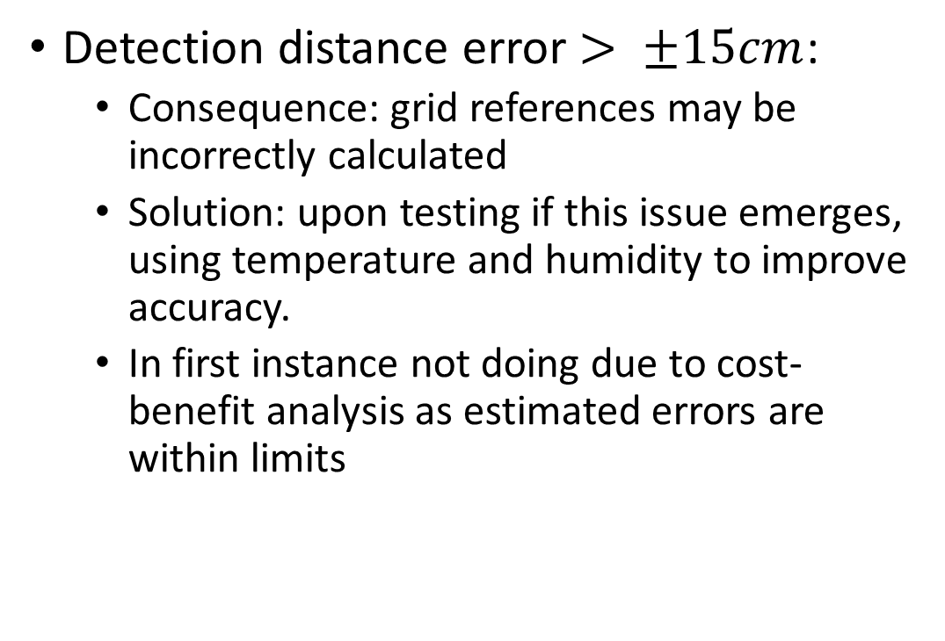
Obstacle Detection System - Risks
Detection distance error $> ±15cm$:
Consequence: grid references may be incorrectly calculated
Solution: upon testing if this issue emerges, using temperature and humidity to improve accuracy.
In first instance not doing due to cost-benefit analysis as estimated errors are within limits

Slide 5
Obstacle Detection System - Risks
Software uses > 20% on board Arduino resources:
Consequence: May not be enough resources for all sub-system scripts
Mitigation: Apply efficient programming principles
Solutions:
1. Purchase a Teensy

Slide 6
Obstacle Detection - Risks

